Slide 1
CREDIT RISK MODELING
Professor Amir Zemoodeh
            GROUP – 04
            SUBHAM MANGI– SCM240000
            SHREYAS HARISH – SXH240028
            GRAYSON SHERIDAN – GBS240000

Slide 2
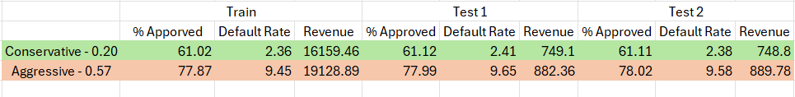
EXECUTIVE SUMMARY
Aggressive Strategy : focusing on achieving the highest returns by engaging with higher-risk clients who may have increased chances of defaulting.
Conservative Strategy : A more conservative strategy that prioritizes safer clients in order to achieve consistent returns while reducing the risk of defaults.

Slide 3
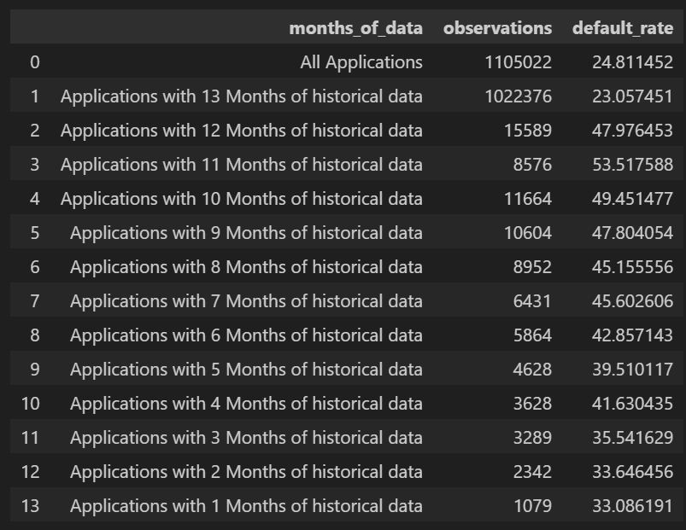
DATA
April 2018 Originations
Selected for statistical representation of typical lending patterns.
Default Rate Analysis
Tracked across multiple time periods to identify cyclical trends.
Comprehensive Coverage
Provides optimal balance of historical data and current relevance.

Slide 4
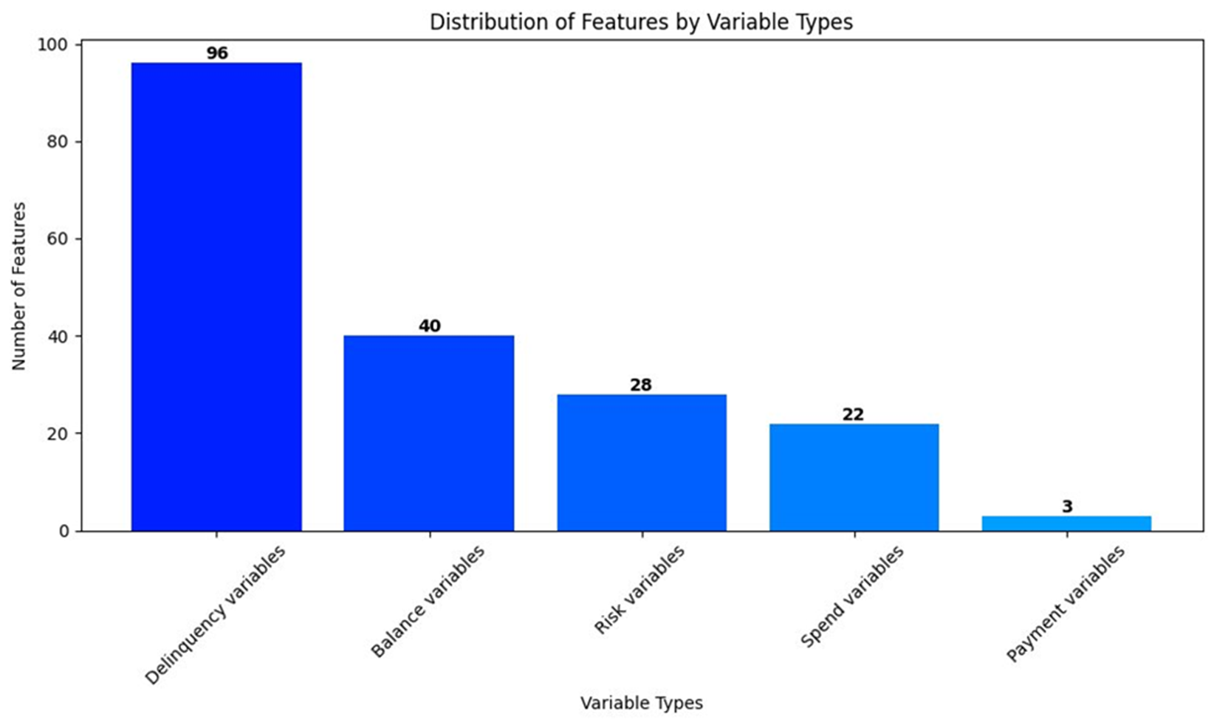
Features
Variable Type | No. of Features | Description
D | 96 | Delinquency variables
B | 40 | Balance variables
R | 28 | Risk variables
S | 22 | Spend variables
P | 3 | Payment variables

Slide 5
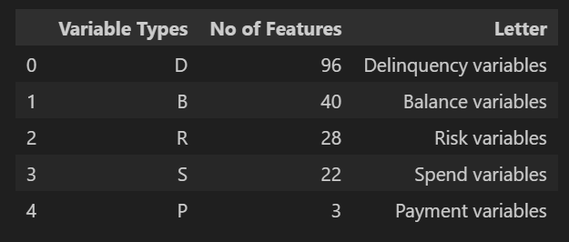
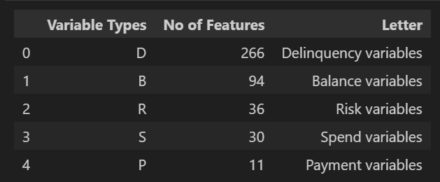
Feature Engineering
Numerical Aggregation: Performed sum and mean for 3 months, 6 months and 12 months on numerical columns.
Categorical Aggregation: Implemented 'Response rate in last 6 months', 'Ever responded in last 12 months', 'Response rate in 2018' feature on categorical columns.

Slide 6
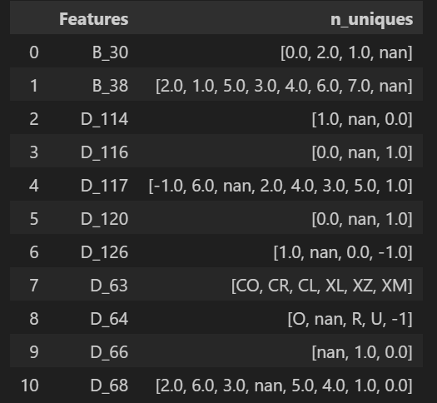
Data Processing / One-Hot Encoding.
Total no of category values combined in all category variables is :45
Total no of Null variables is :10
Total no of columns to be added after OHE is : 55
Total Columns in original Data Frame : 191
Total Columns after OHE is : 235

Slide 7
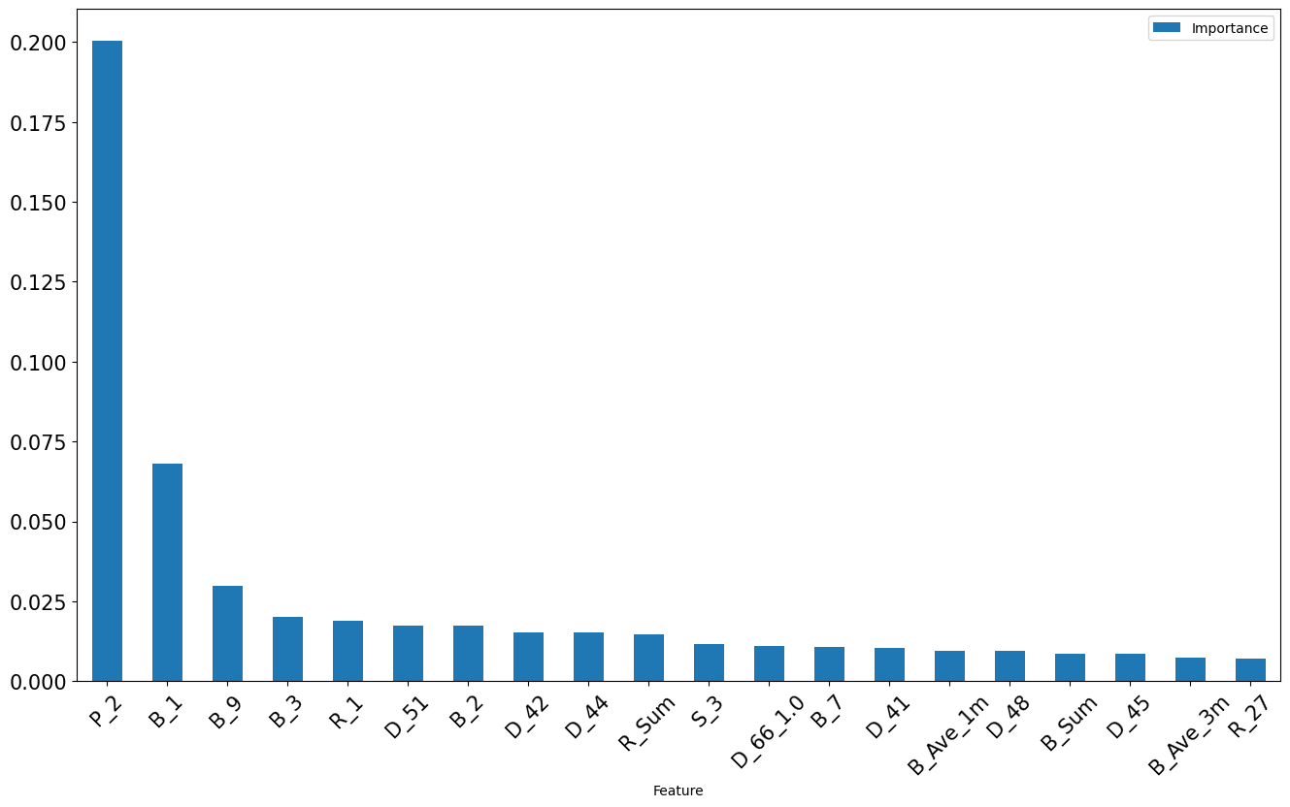
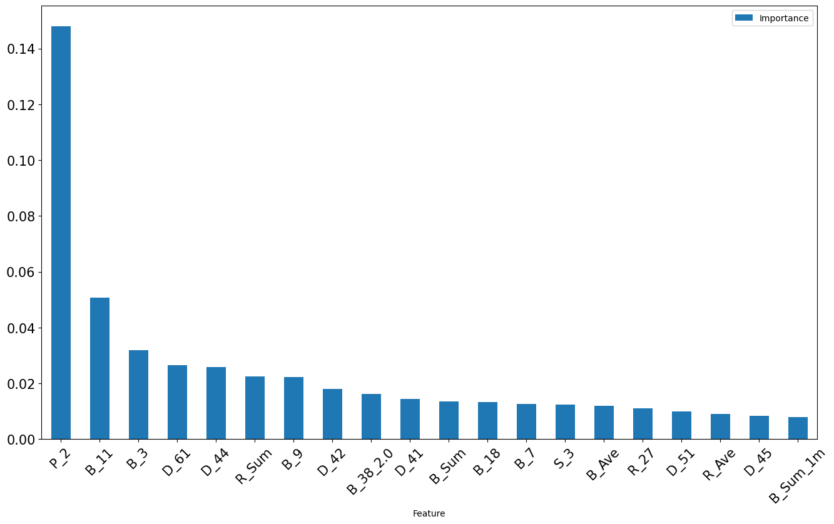
Feature Selection

Slide 8
XGBoost Classifier model
XGBClassifier(
n_estimators=300,
learning_rate=0.5,
subsample=0.5,
colsample_bytree=0.5,
scale_pos_weight=5
)
Key Notes:
n_estimators = 300: Builds 300 boosted trees
learning_rate = 0.5: Higher learning rate for faster convergence
subsample=0.5 controls the fraction of observations used for each tree
colsample_bytree = 0.5: Uses 50% of the subsample ratio of columns when constructing each tree
scale_pos_weight=5: Indicates the ratio of number of negative class to the positive class.

Slide 9
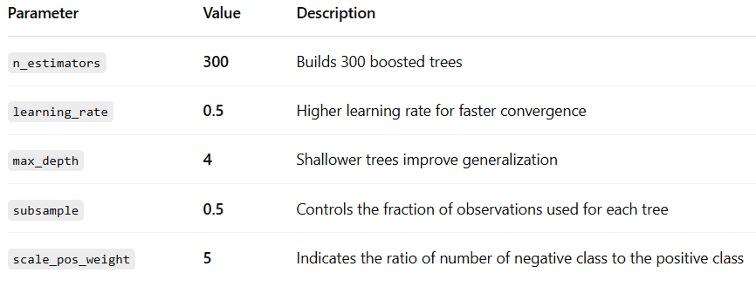
XGBoost Classifier Configuration

Slide 10
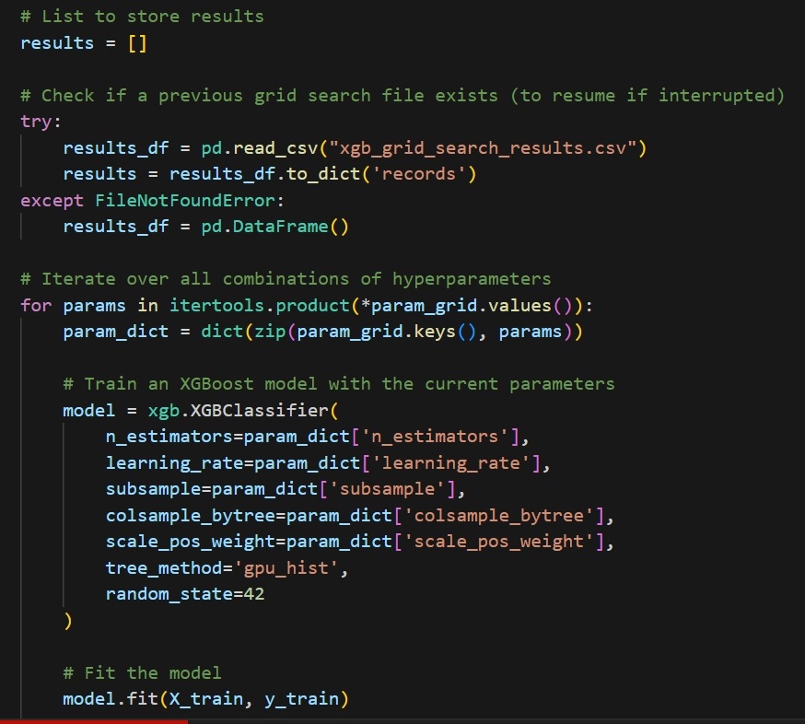
XGBoost – Grid Search
Each parameter combination is tested and its performance recorded.
Helps identify the best model settings (e.g., tree count, learning rate, sampling ratios, class weights).
Ultimately, it improves accuracy and reduces overfitting, while handling imbalanced datasets (via scale_pos_weight).
The model is trained on the training dataset (X_train, y_train).
Initializes an XGBoost classifier with the current set of hyperparameters.
Uses GPU acceleration (tree_method='gpu_hist') for faster training.

Slide 11
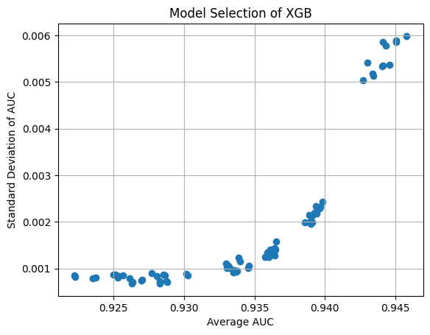
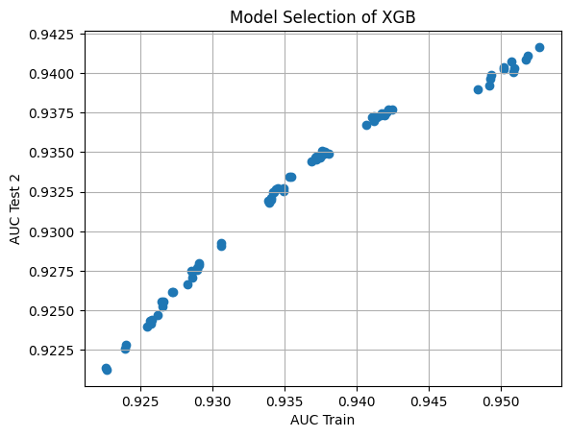
XGBoost – Grid Search

Slide 12
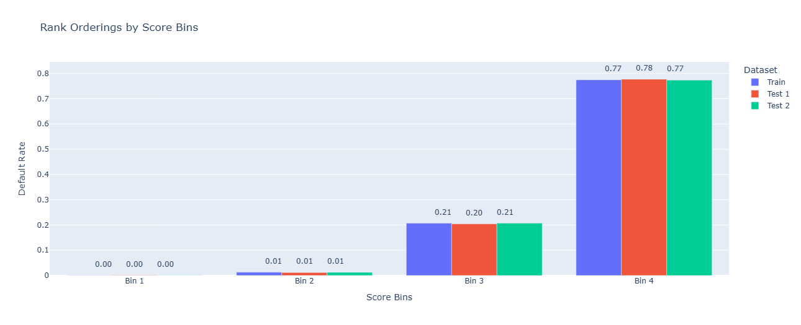
XGBoost – Final Model
We have selected best model parameters using overfit metric, Bias and Variance
#Trees: 300.000000 ​
LR: 0.100000 ​
Subsample: 0.800000 ​
% Features: 0.500000 ​
Weight of Default: 1 ​
AUC Train: 0.950735​
AUC Test 1: 0.942310 ​
AUC Test 2: 0.940764 ​
Bias: 0.009198 ​
Variance: 0.001546 ​

Slide 13
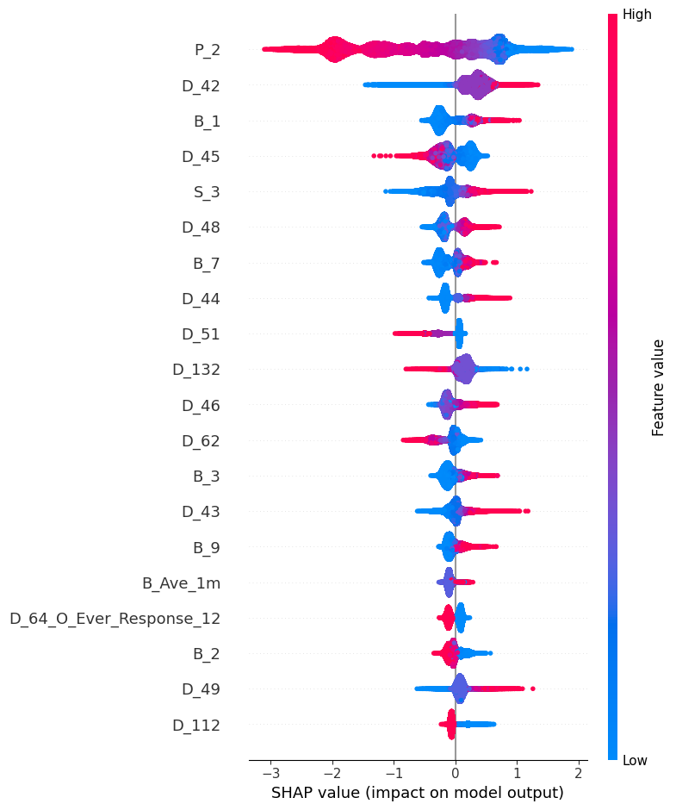
XGBoost – SHAP Analysis
This plot explains how every feature influences the probability prediction.
P_2 is the most influential feature:
High P_2 values (red) decrease default probability.
Indicates a negative correlation with default risk.
D_42, B_1, D_45, S_3, D_48 are also highly impactful:
Low values (blue) generally increase the default probability.
Positively correlated with default risk.
D_64_O_Ever_Response_12 and B_Ave_1m have minor but meaningful influence.
SHAP values show feature impact on individual predictions:
Right side = increase in default risk.
Left side = decrease in default risk.
The wider the spread, the greater the variability in impact across the dataset.

Slide 14
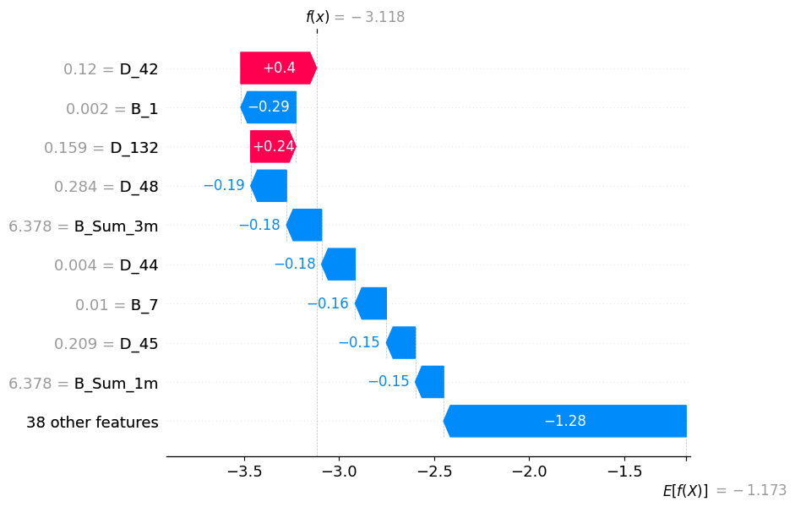
XGBoost - SHAP Analysis
This is a SHAP waterfall plot, which explains how different features contribute to the model’s prediction for a specific instance.
Features like D_42 and D_132 increased the prediction score, while others like B_1, D_48, and B_Sum_1m significantly reduced the default probability, leading to a low final prediction score of -3.118.

Slide 15
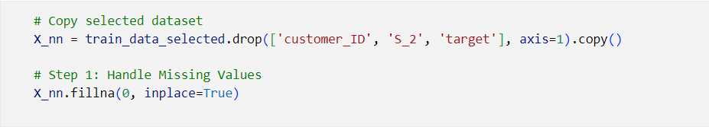
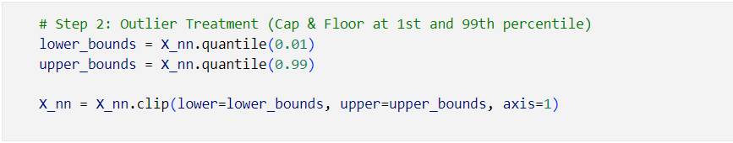
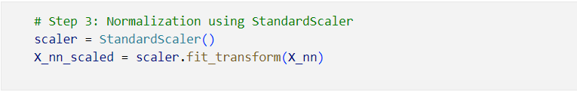
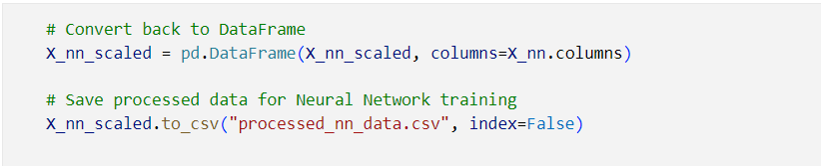
Neural Network – Data Processing

Slide 16
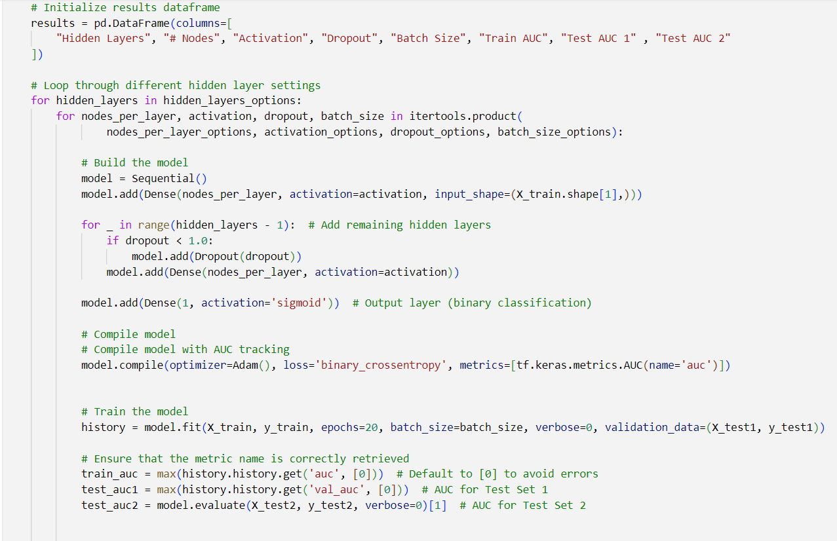
Neural Network – Grid Search

Slide 17
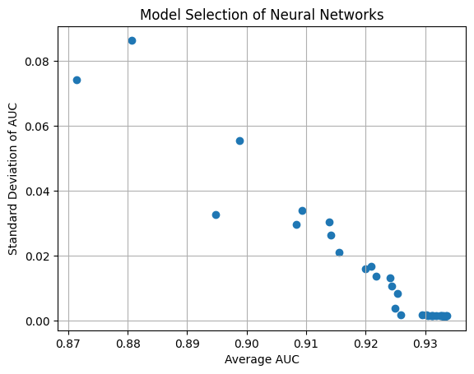
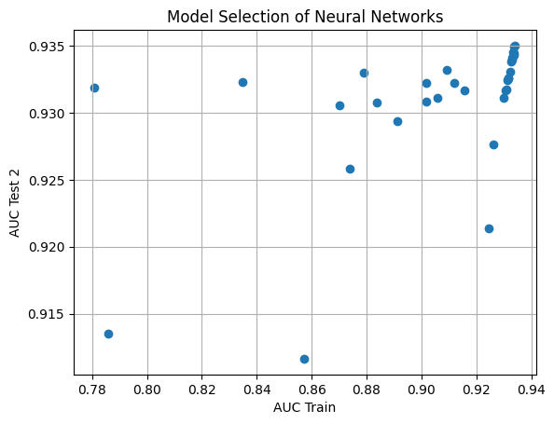
Neural Network – Grid Search

Slide 18

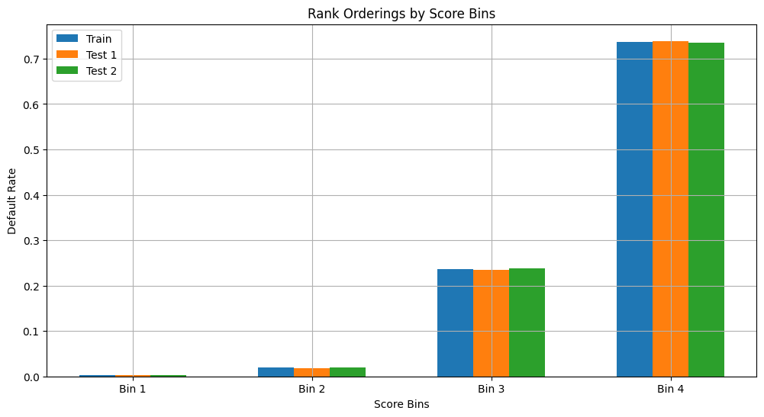
Neural Network – Final Model

Slide 19
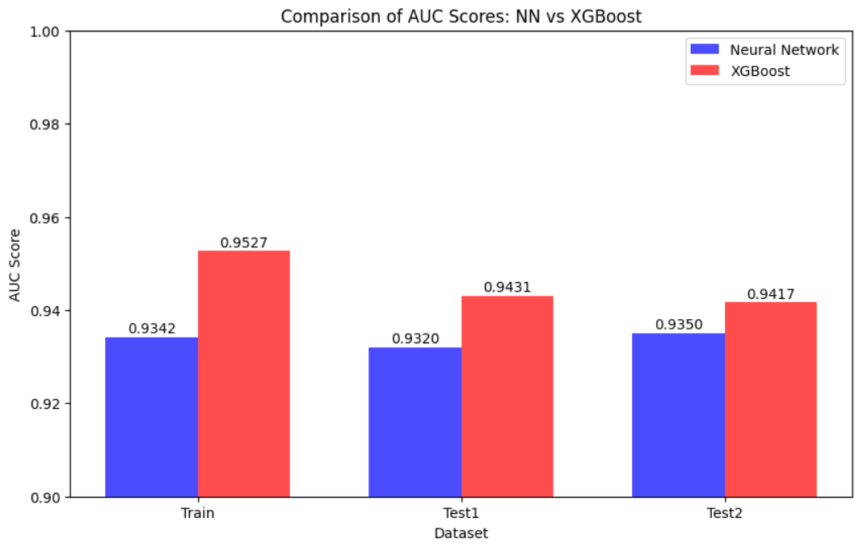
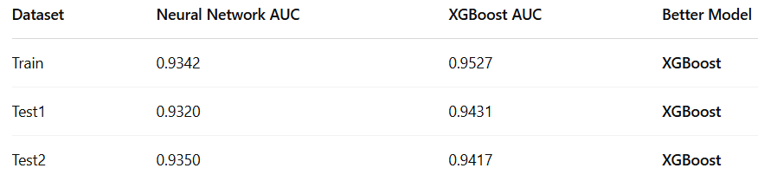
Final Model
The bar chart presents a visual comparison of AUC scores for the Neural Network and XGBoost models across three datasets: Train, Test1, and Test2. In every case, the XGBoost model (red bars) consistently outperforms the Neural Network model (blue bars), indicating stronger performance in both training and generalization. XGBoost achieved the highest AUC of 0.9527 on the training set, while also maintaining strong test scores above 0.94, making it the preferred choice for this credit risk modeling task.

Slide 20
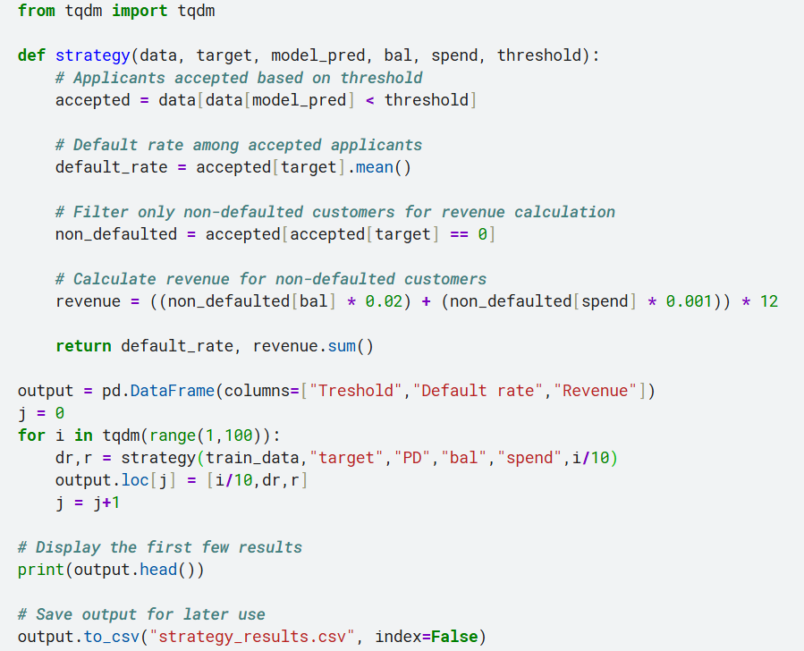
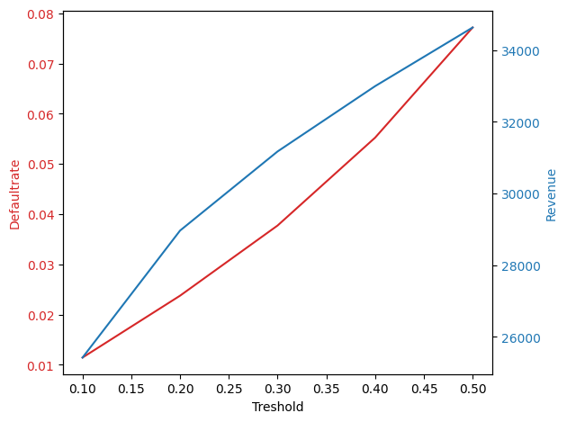
STRATEGY

Slide 21
